Slide 1
GFW Raster processing

Slide 2
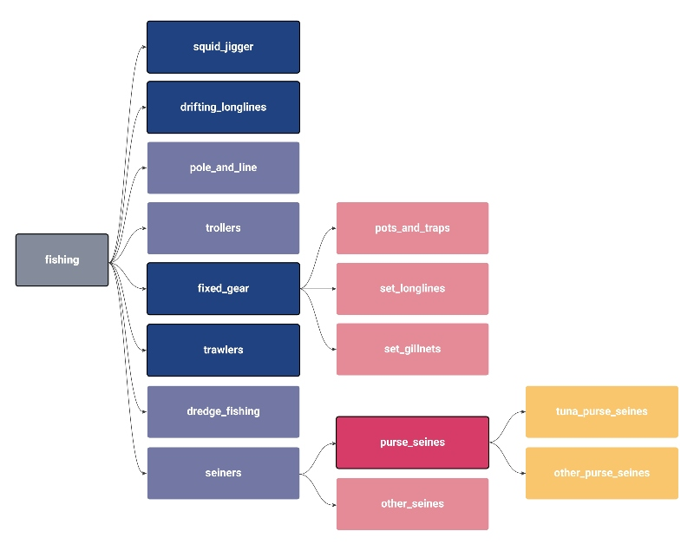
GFW data
Fisheries data from all the globe (fishing hours)
2012-2020
Different fishing gears
Other data: Flag,hours,mmsi present
Monthly/daily data
Standarization (GFW v2)

Slide 3
Aim
Rasters of a month/year (sum of values) from daily data
Accesible database
Multiple databases

Slide 4
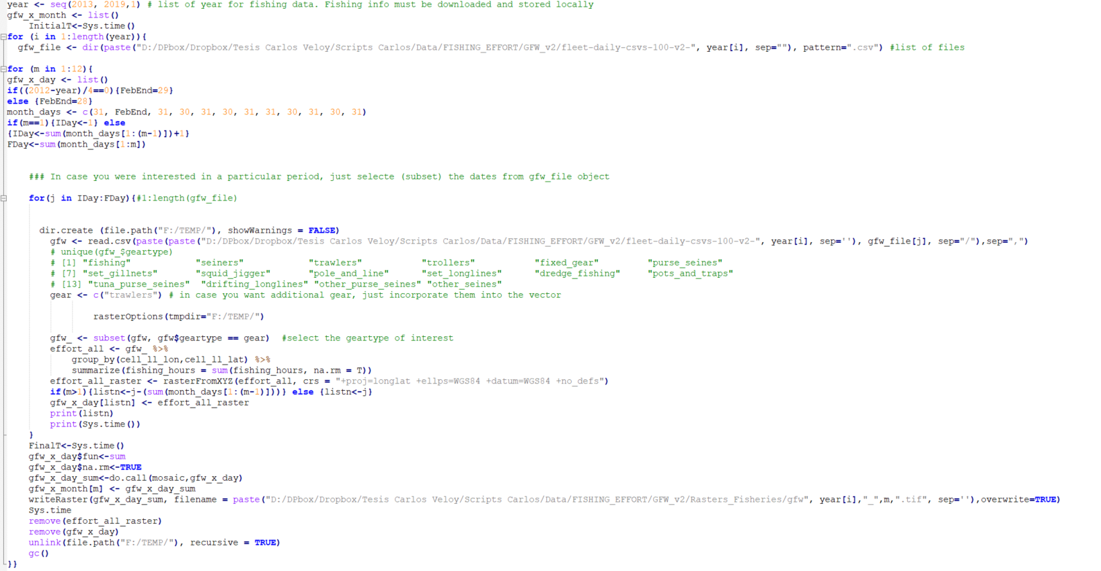
Script
Initialization of objects and labels
1- Filter dataframe and create daily rasters
2- Sum all the daily rasters (mosaic)
Workspace cleanup
Output: 12 month rasters (gfw[year]_[month].tif)

Slide 5
Other notes
Requirements: >70 GB of free HDD (temporal files)
Duration of a month loop*: ~30 min
Duration of a year loop*: ~7 hours
*Selecting only trawlers

